Slide 1
Web Performance Hacks 😎
@saurabhdaware

Slide 2
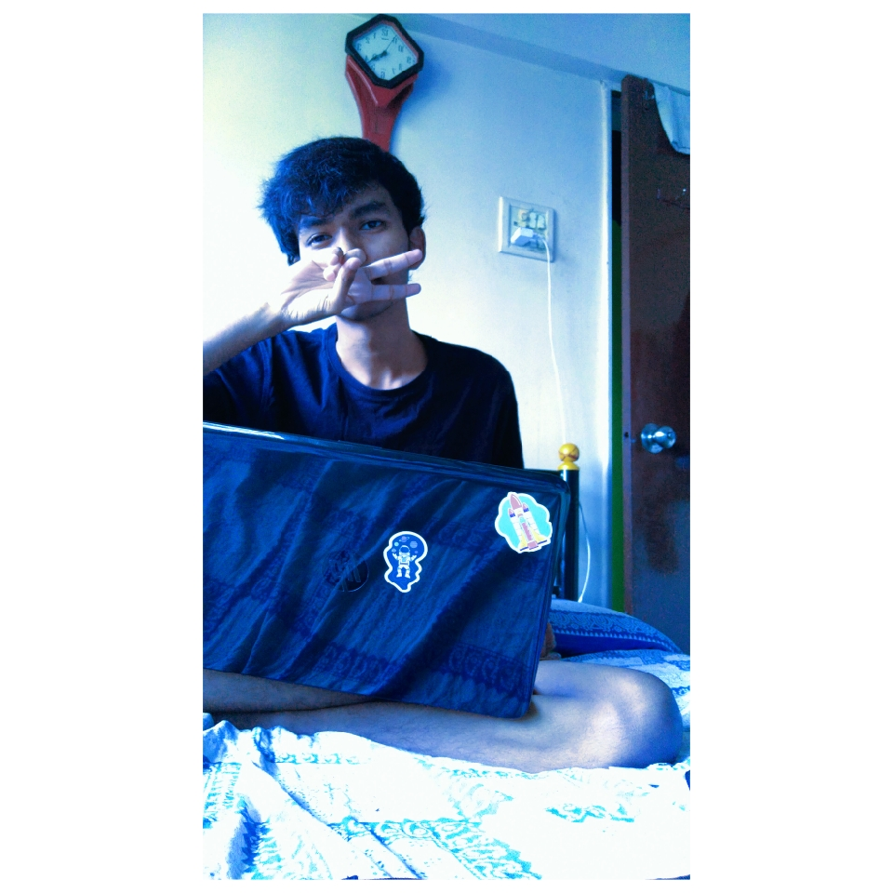






Saurabh Daware
Workz at da Student
Open Source Fanboi🌻
Previously (Intern) -
@saurabhcodes
/saurabhdaware
saurabhdaware.in
Bew Digital

Slide 3
Ready?

Slide 4
Hack #1

Slide 5

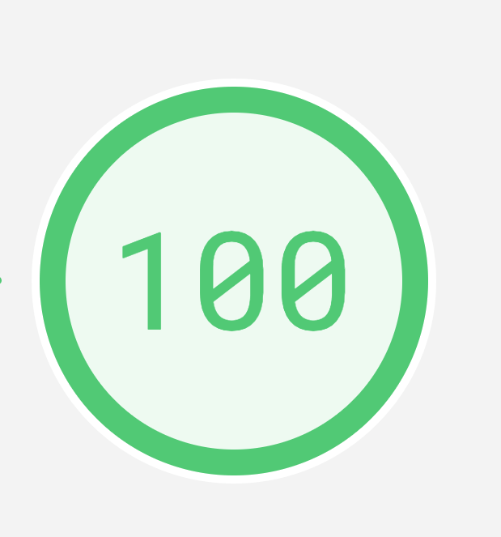
<html>
<body>Hello, World!</body>
</html>
Replace your whole code with...
🎉
Performance

Slide 6
How does the web work?

Slide 7
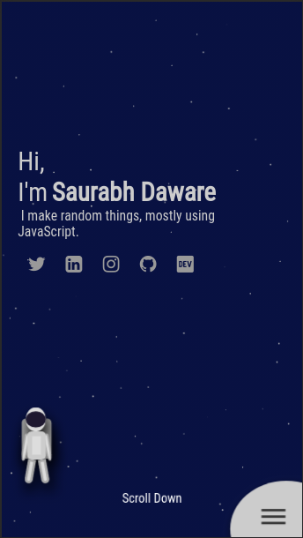
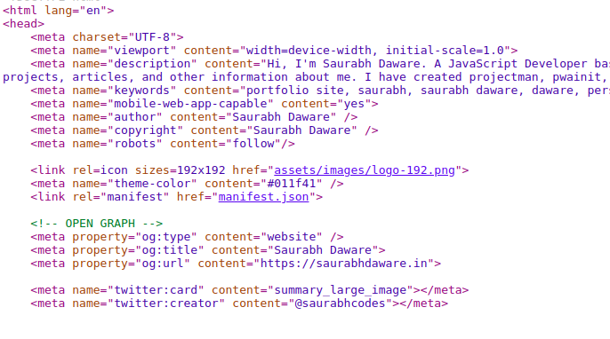
https://saurabhdaware.in
Server
Parsing & Rendering🎉
Magic

Slide 8
HTML Parsing
& Rendering
(a zoomed out view)

Slide 9
<html>
<head>...</head>
<body><div><span>Hello</span></div></body>
</html>
HTML
Tokenization
[Start: HTML] [Start: HEAD] … [End: HEAD] [Start: BODY] [Start: DIV] [Start: SPAN]
HTMLElement
DOM Tree
HeadElement
BodyElement
LinkElement
DivElement
SpanElement
Hello

Slide 10
CSSOM Tree
body
font-family: Arial
img
div
width: 300px
Padding: 50px
span
Font-size: 9pt;
Color: #09f

Slide 11
Parse HTML
DOM Tree
Render Tree
Layout
Paint
Parse CSS
CSSOM Tree

Slide 12
Parsing halts when it comes across <link>, <script>, and <style> tags.

Slide 14
CSS
JavaScript
Images

Slide 15
‘A quick First Paint’ hack

Slide 16
Lets Code!!!!

Slide 17
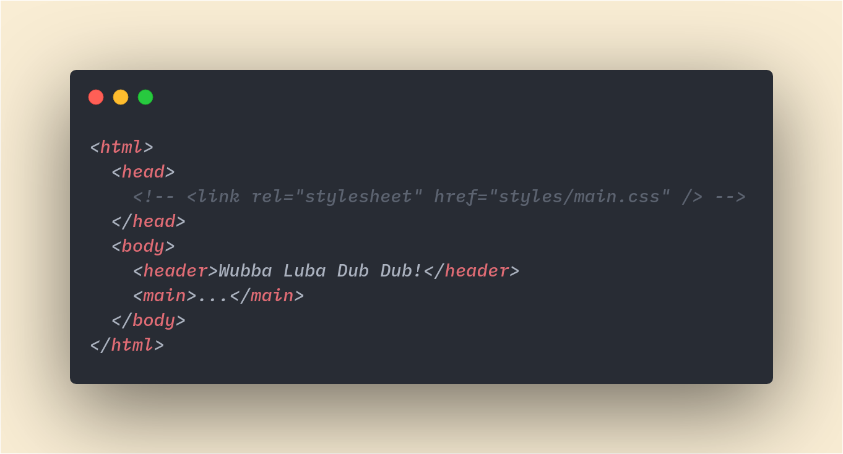
Without CSS

Slide 18
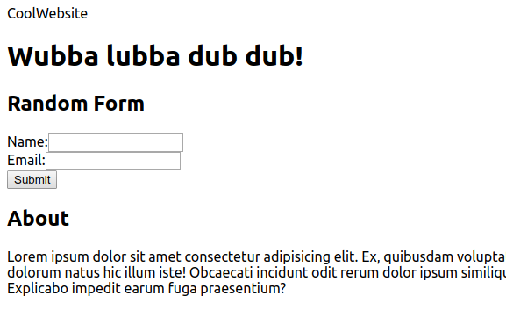
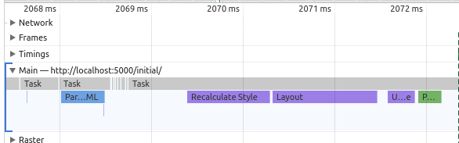
2s

Slide 19
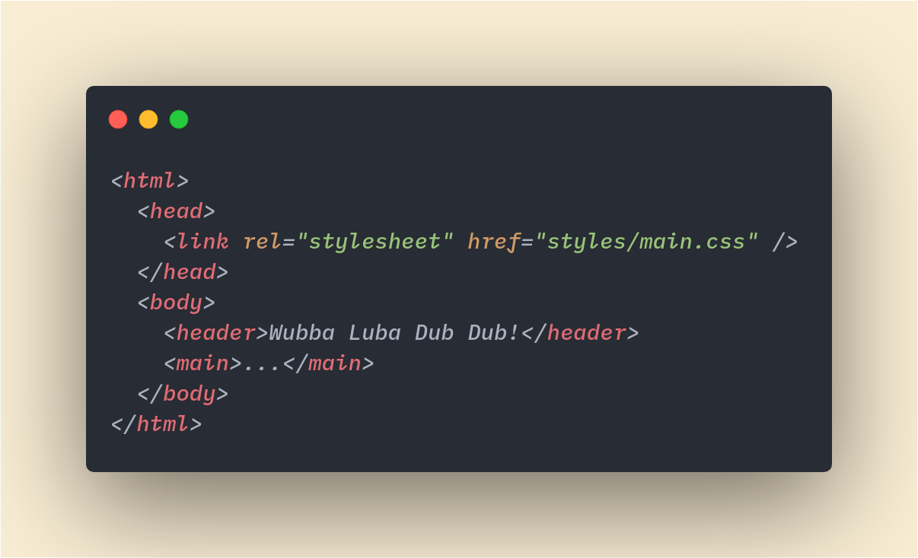
With CSS

Slide 20
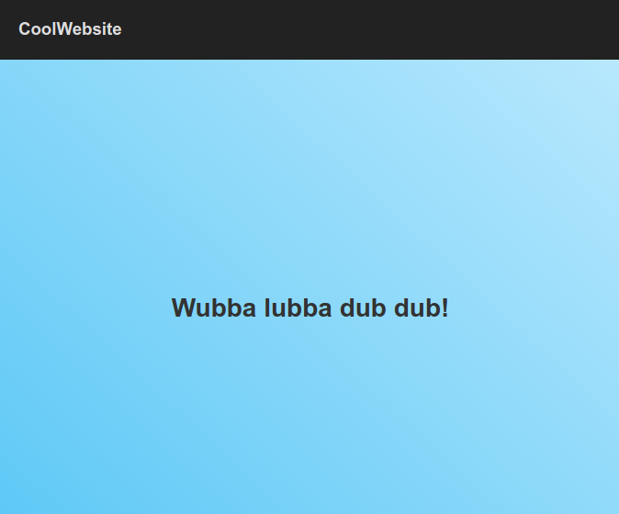
0s - 3.9s
4s

Slide 21
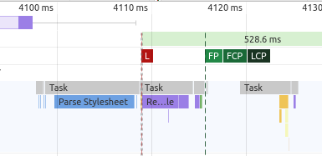

Slide 22
Render waits for CSS to load

Slide 23
How about rendering the HTML content first and painting on screen and then applying CSS?

Slide 24
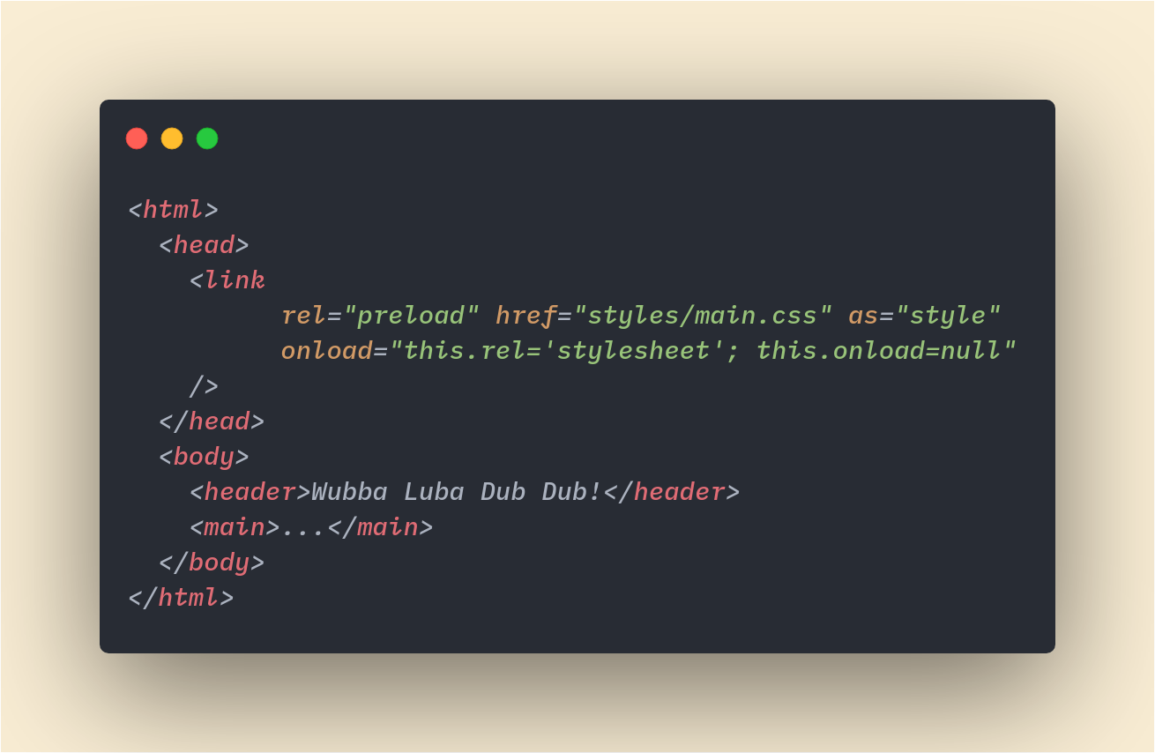

Slide 25
0s - 1.9s
2s - 3.9s
4s

Slide 26
Just showing HTML is bad UX

Slide 27
Inlining critical CSS

Slide 28
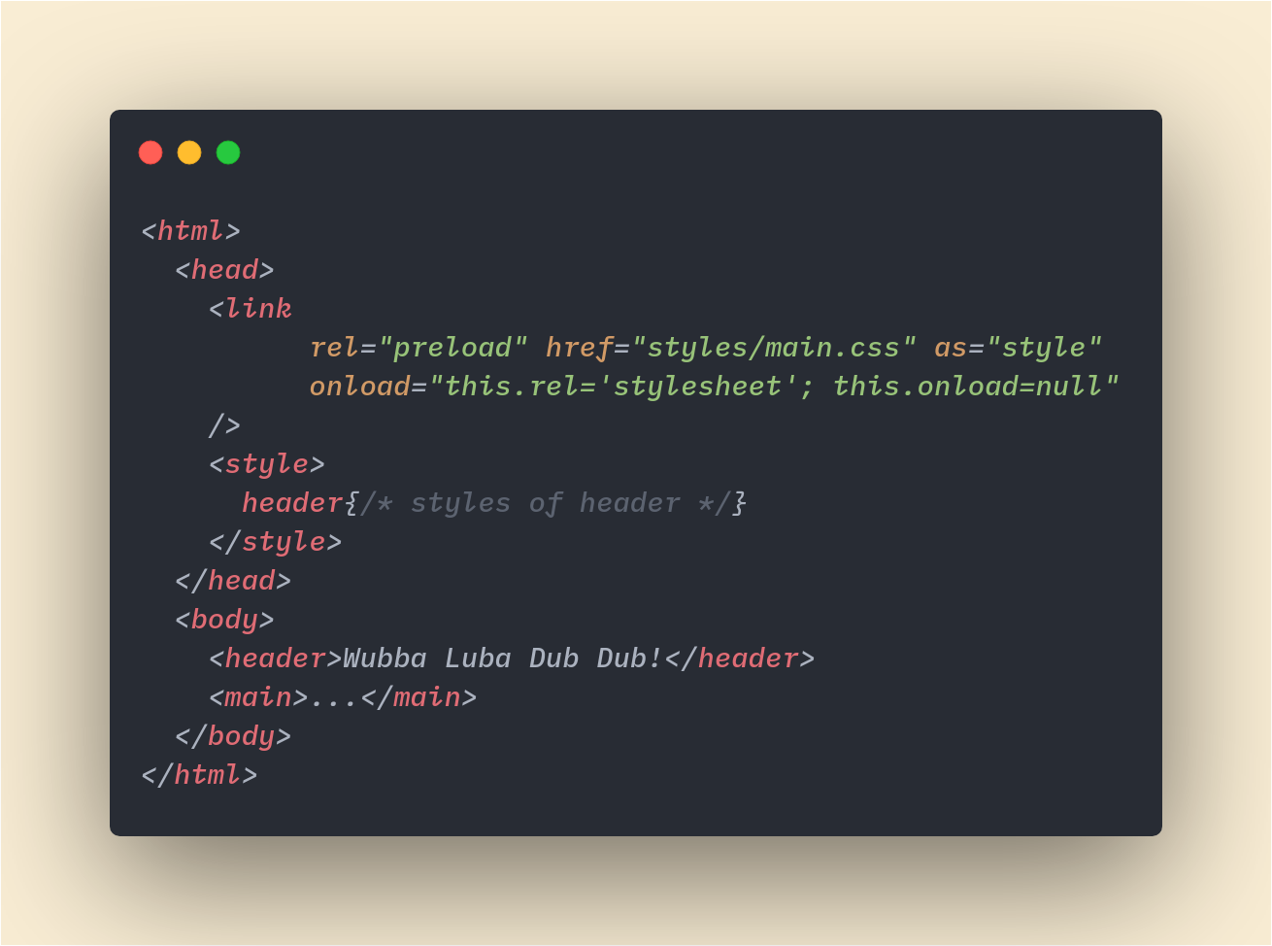

Slide 29
0s - 1.9s
2s - 3.9s
4s
Only header css without css for other content outside the viewport
Full CSS

Slide 30
HTML Parsing
Parsing Paused
Script Download
Script Execution
<script>
<script async>
<script defer>

Slide 31
Code-splitting

Slide 32

app.64a0051a.js
contact-chunk.61a0051a.js
home-chunk.34a0051a.js
about-chunk.24a0051a.js

Slide 33
Image Optimization

Slide 34
<img src=“....” loading=“lazy” />

Slide 35
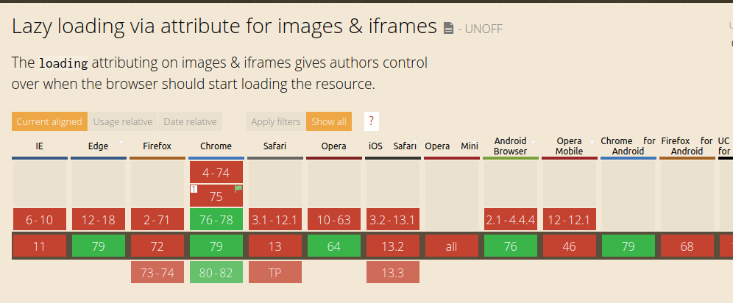

Slide 36
Polyfill:
https://github.com/mfranzke/loading-attribute-polyfill

Slide 37
Progressive JPEGs

Slide 38

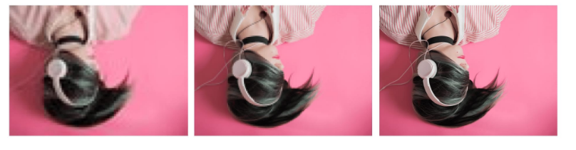
JPEG
Progressive JPEG

Slide 39
CDN

Slide 40
https://res.cloudinary.com/saurabhdaware/image/upload/c_scale,fl_progressive,w_300/v1526463112/Screenshot_87_baiu9r.jpg

Slide 41
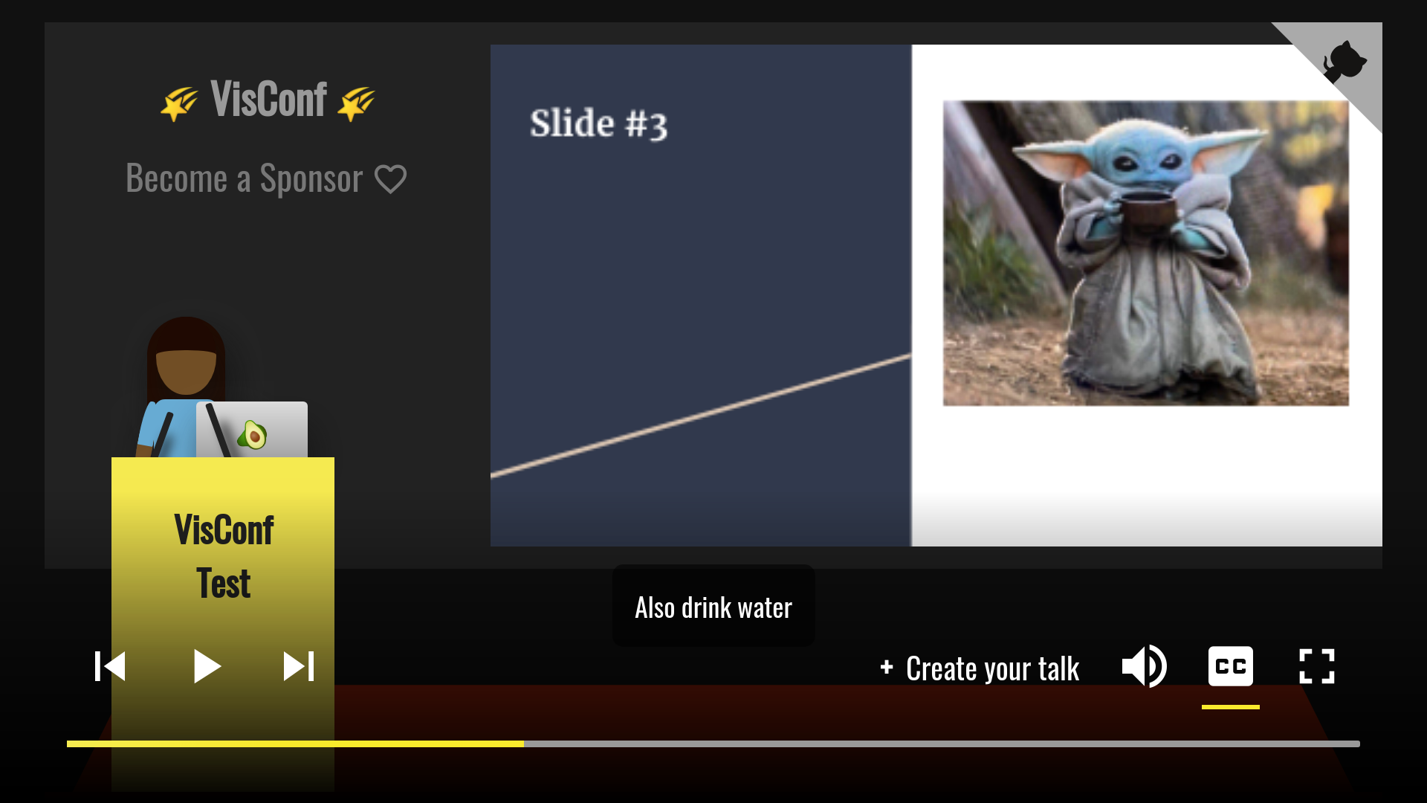
https://github.com/saurabhdaware/visconf

Slide 42

Thank You!
Questions?
@saurabhcodes
/saurabhdaware
saurabhdaware.in

Slide 43
Extra Slides

Slide 44


Slide 45
Fancy Keywords to Google Search:
Inlining Critical CSS
QuickLinks (https://github.com/GoogleChromeLabs/quicklink)
InstantClick (http://instantclick.io/)
Web Workers, Web Assembly, OffScreenCanvas
Service Workers
Predictive Prefetching

Slide 46
Async vs Defer : https://stackoverflow.com/questions/10808109/script-tag-async-defer
Script attributes: https://eager.io/blog/everything-I-know-about-the-script-tag/
RenderTree Constructions: https://developers.google.com/web/fundamentals/performance/critical-rendering-path/render-tree-construction
Rendering Behind the scene: https://blog.logrocket.com/how-browser-rendering-works-behind-the-scenes-6782b0e8fb10/
Ryan Seddon:
https://www.youtube.com/watch?v=SmE4OwHztCc
JPEG to Progressive JPEG
https://imagemagick.org/index.php

